Slide 1
Digi Diary
IP Project Shrish M 200701236

Slide 2
Problem statement
This web-app aims to bring back the joy of writing journals and maintain diary in a robust, secure and digital way. The client can sign-up onto our website by entering their details and set their own password. Then they could log into their accounts to write a journal about something or read their previous journals. With password protection they could ensure none but themselves could access their personal writings. This provides a sense of privacy to them and their intimate journals. The web-app can be accessed from any device that has a browser in it. This means the user can access the web-app from anywhere.

Slide 3
Aim and objectives:
Ensure the privacy of the clients are protected.
Use session handling to manage user-login.
Store the user writings in an encrypted form.
Ensure compatability through all devices and browsers

Slide 4
scope
Journaling is an old art. This app aims to give a digital form to it. Doing so would attract a lot of clients, especially the youths.
With the ease the app provides clients can manage their writings seamlessly.

Slide 5
Hardware and software specifications
Function/Requirement | Specification
Hardware | Any device with a browser and internet
Frontend | Html,css,Bootstrap
Backend | Javascript,nodejs,express
Database | Mysql

Slide 6
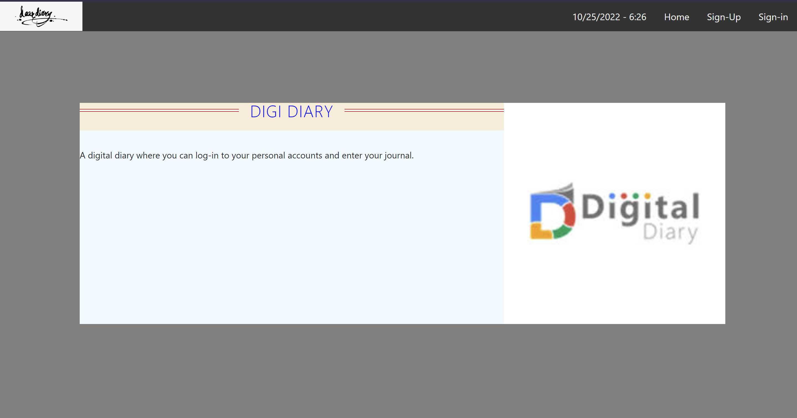
Home

Slide 7
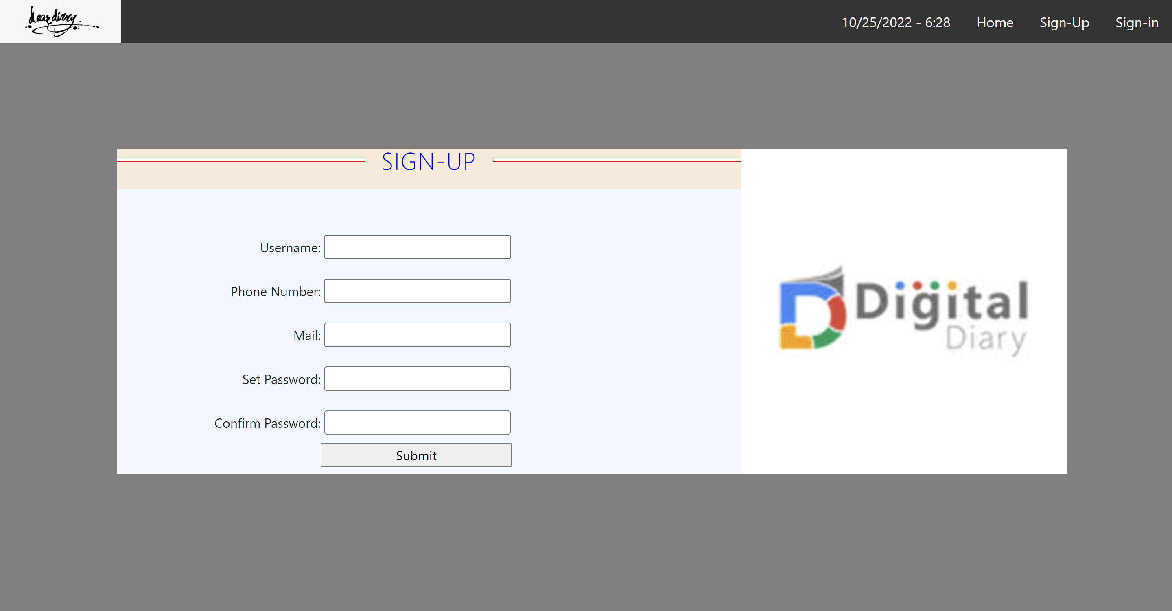
Signup page

Slide 8
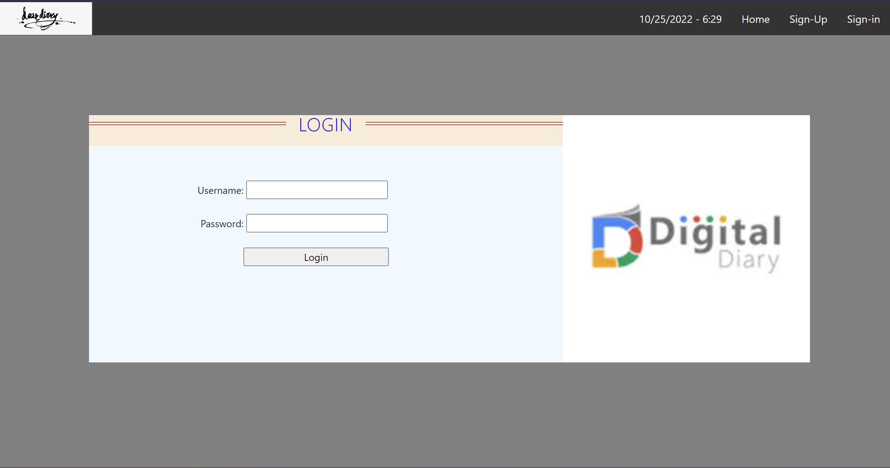
Login page

Slide 9
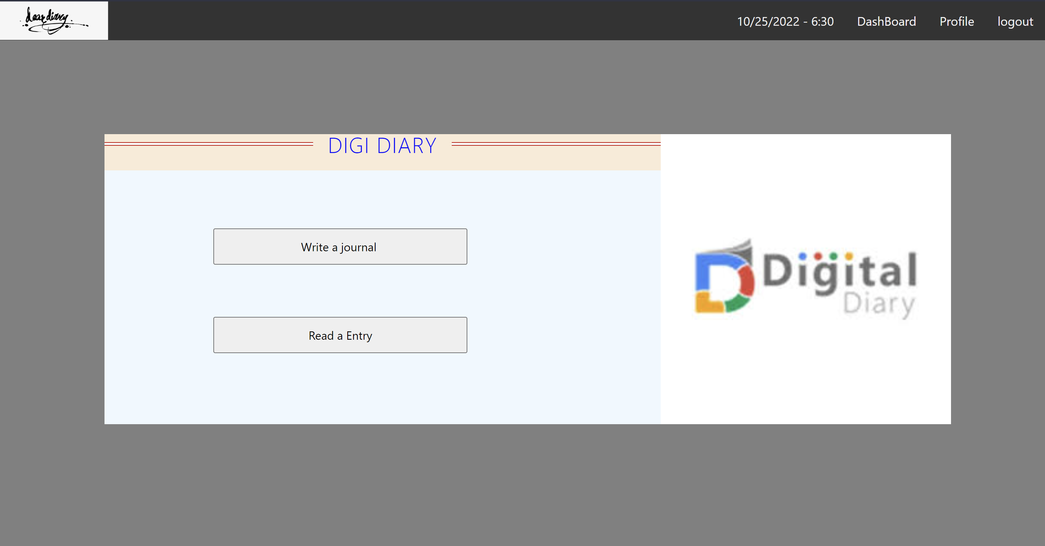
Dashboard

Slide 10
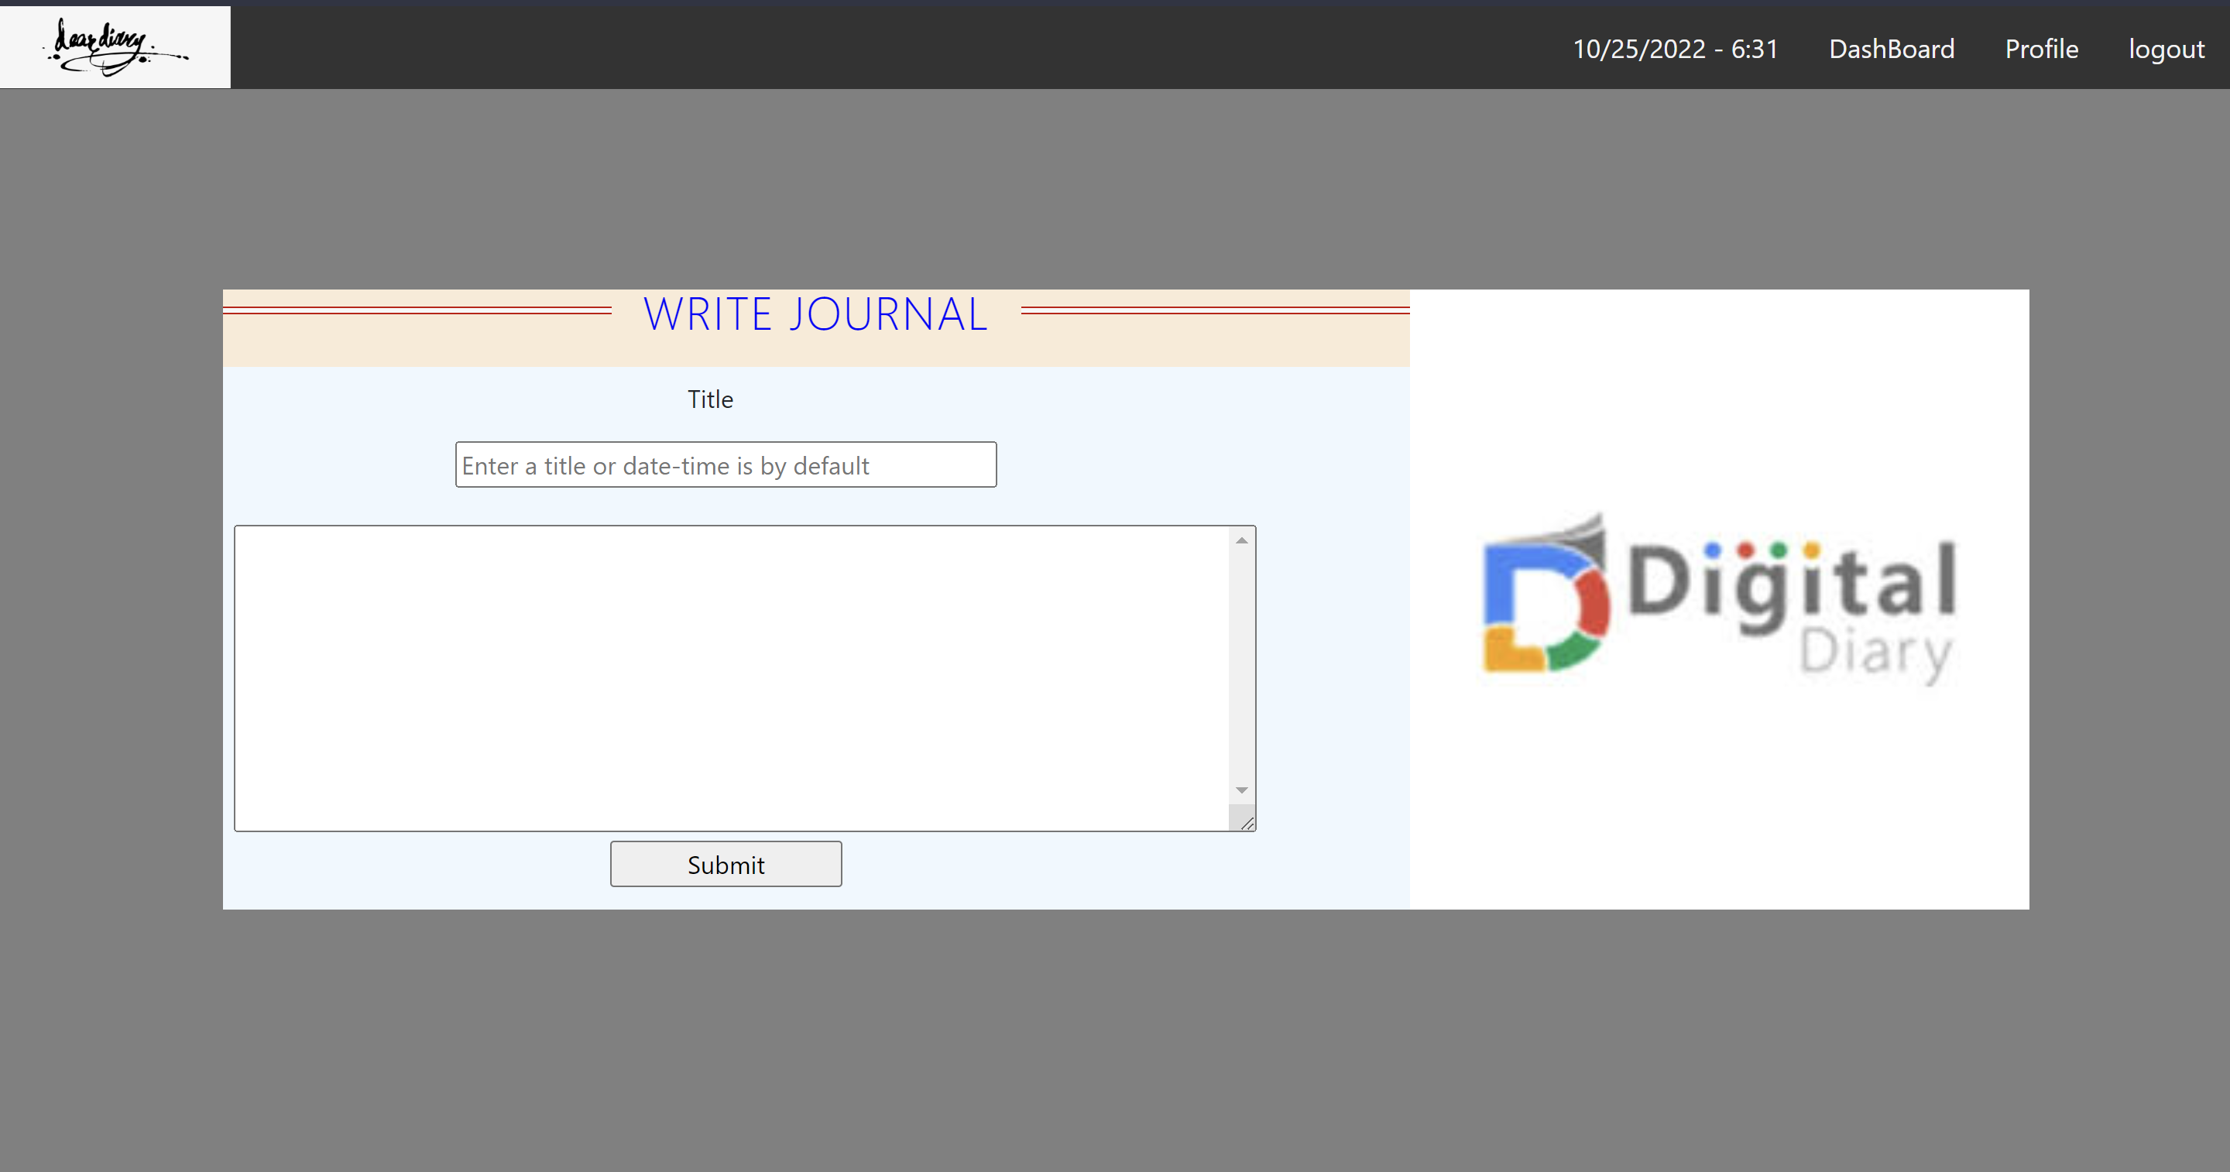
Write journal

Slide 11
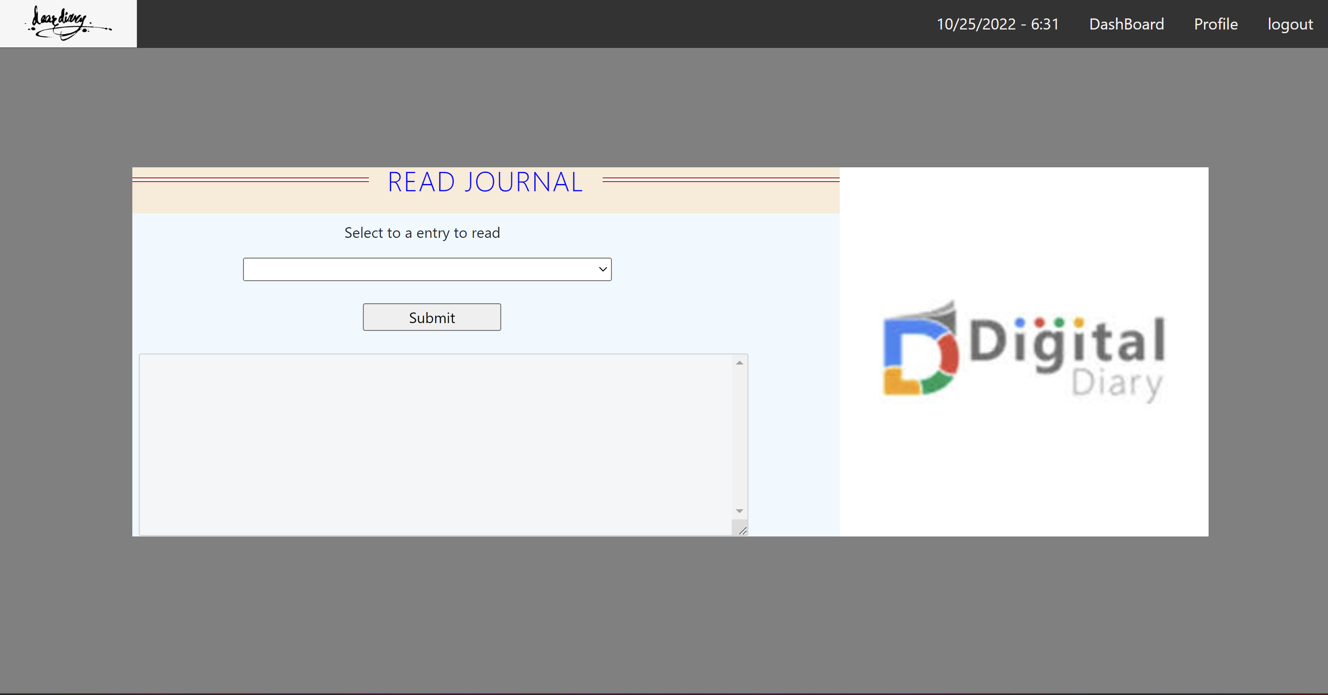
Read journal

Slide 12
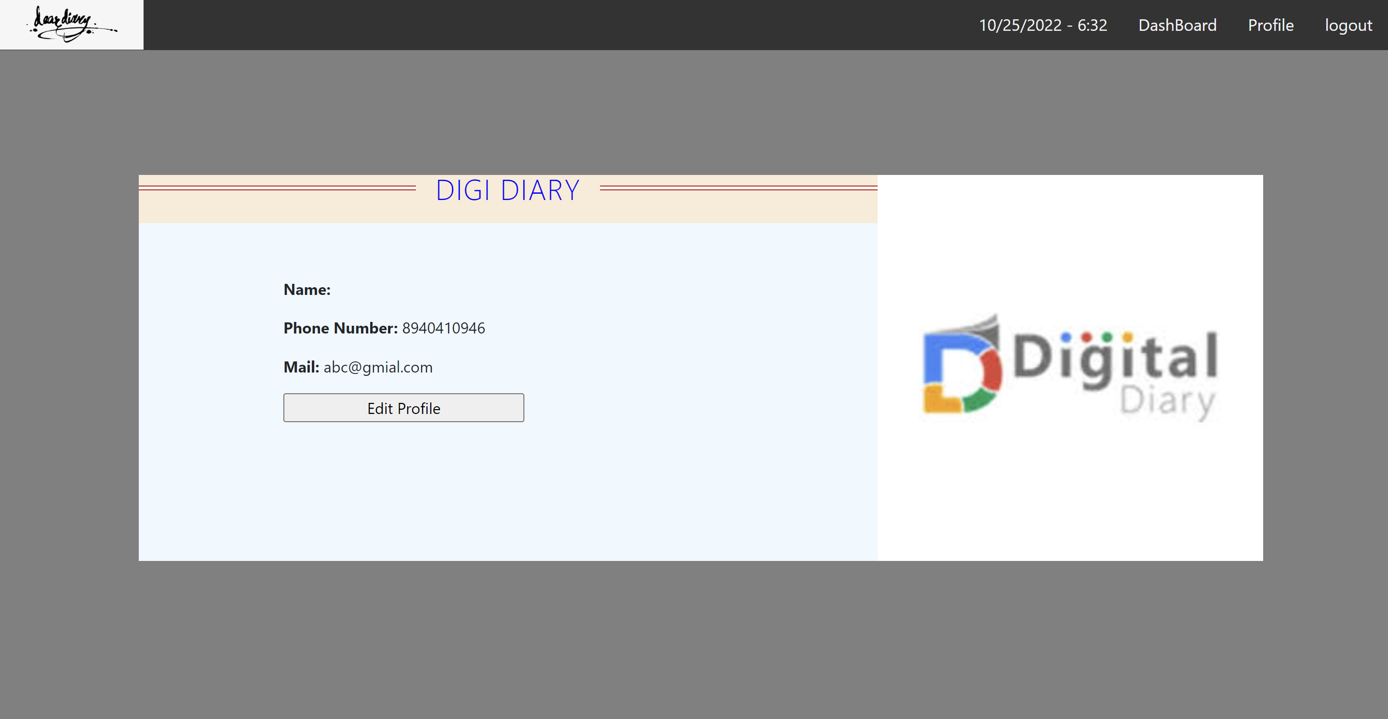
profile

Slide 13
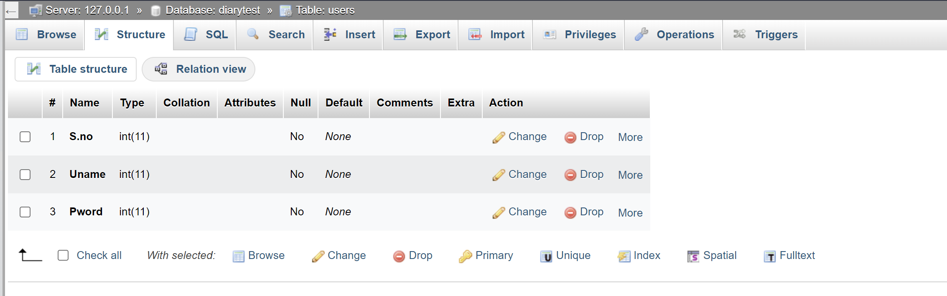
Password database

Slide 14
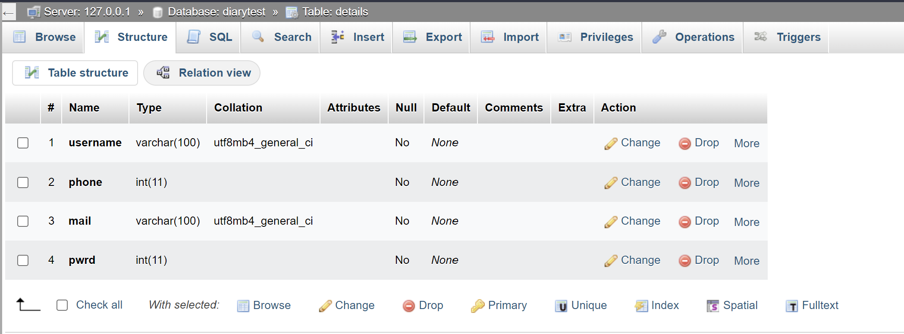
Details database

Slide 15
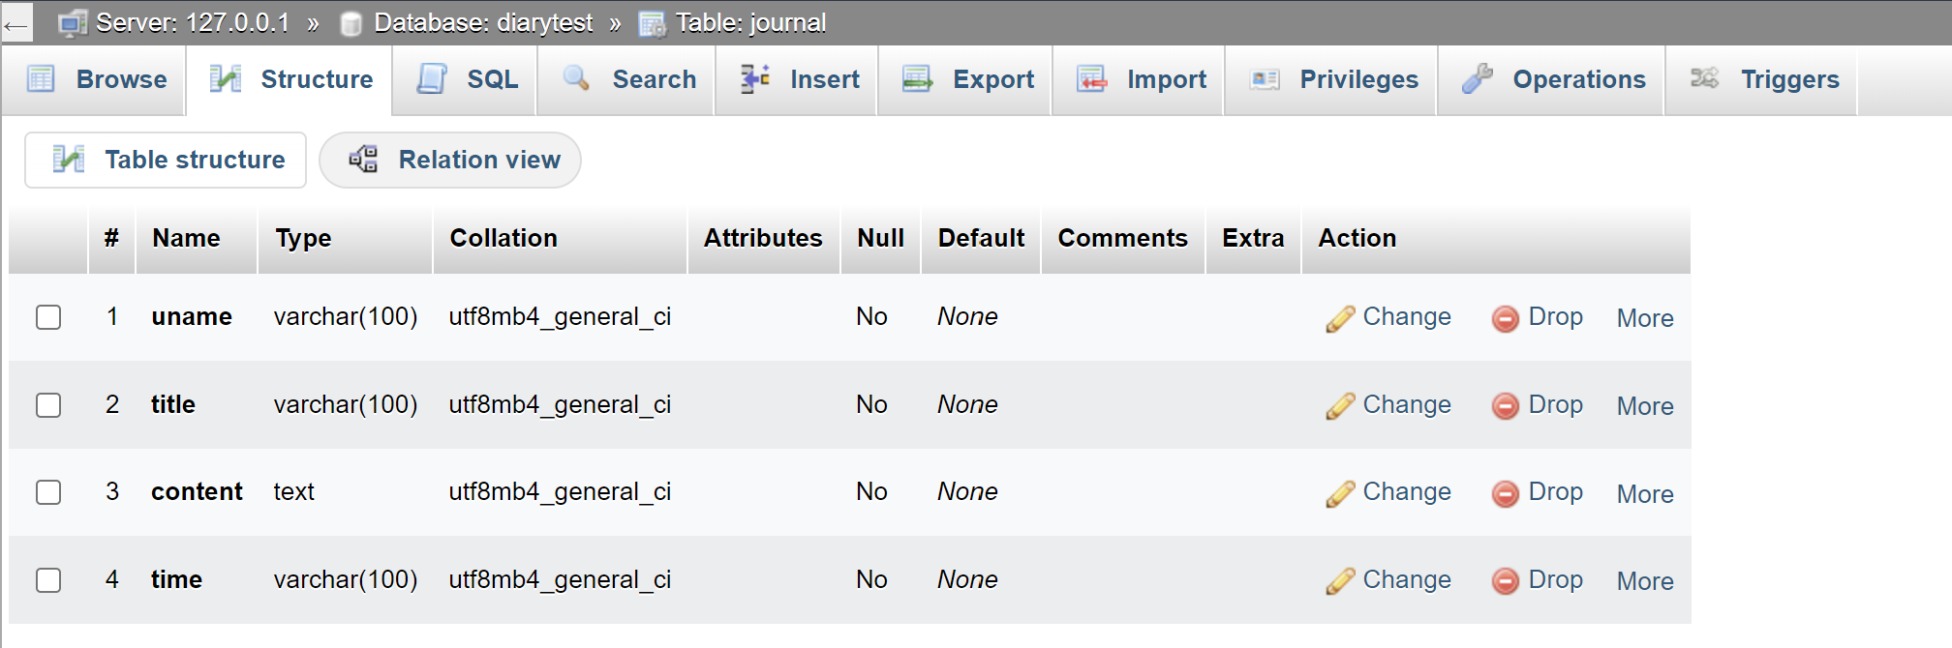
Journal diary

